Slide 1

Traceable Verifiable Random Functions
Dan Boneh , Aditi Partap , Lior Rotem
https://eprint.iacr.org/2025/312

Slide 2





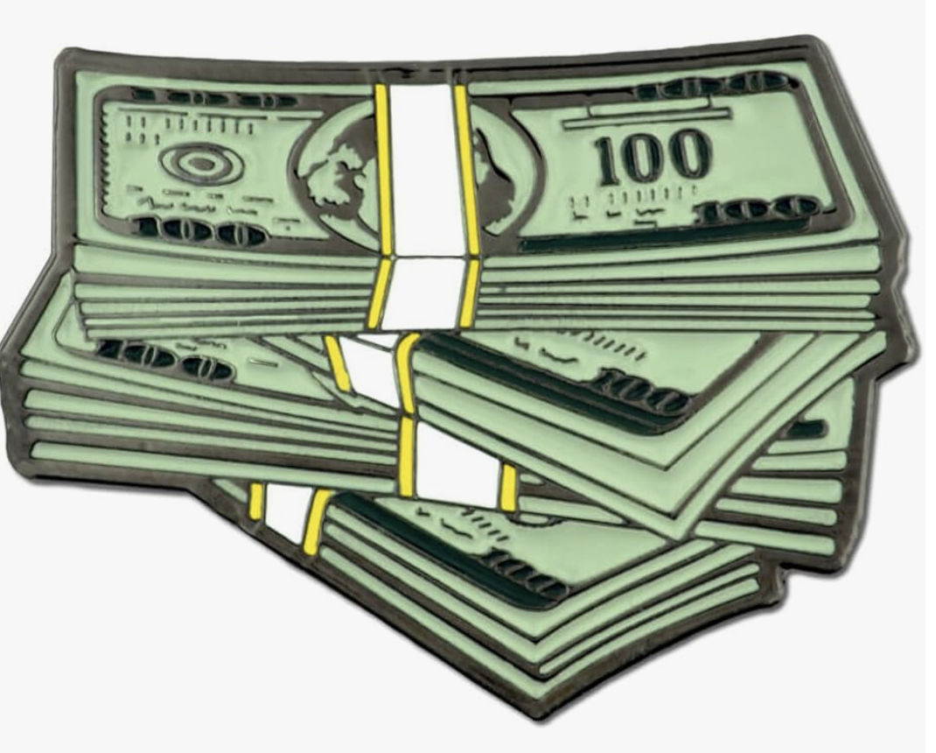
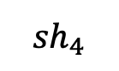
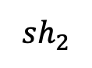
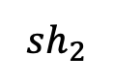
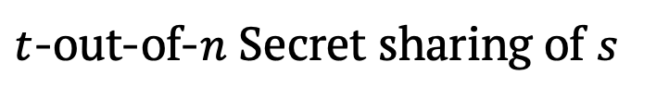
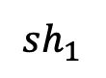
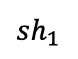
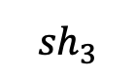
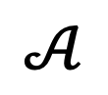
Accountability in Threshold Cryptography
Secret /
Signing key /
Decryption key
How to deter parties from selling their shares?
$t$-out-of-$n$ Secret sharing of $s$
$$sh_{1}$$
$$sh_{2}$$
$${sh}_{3}$$
$${sh}_{4}$$
$$sh_{1}$$
$$sh_{2}$$
$$𝒜$$
Trace
1,2
(Obfuscated)
Notes:
Before I get into VRFs, I wanna briefly talk about accountability in general.
So Threshold cryptography is very commonly used because it allows you to Distribute trust among multiple parties. E.g.
Lets say you want to store some secret data on the cloud but u don’t want any single party to know your data. That’s one example wehre u might use t-out-of-n secret sharing, lets consider there are n=4 cloud providers: then what u can do is use SS to split your data s into shares sh1,sh2…sh4, and u store sh1 with the first cloud provider, sh2 with the second and so on. The guarantee that u get with secret sharing, is that if you want to reconstruct your secret, you only need to talk to t providers and combine their shares, on the other hand, even if t-1 providers collude, they cannot learn anything about your data.
Similarly, we can use this to store a signing key, for a signature scheme, so any t parties can sign a message, and also for threshold decryption: any t out of n parties can decrypt a CT.
But The ques we ask is what happens if parties start selling their shares? E.g. the first 2 parties, lets say alice and bob, agree to sell their shares to the adv.
In most existing threshold crypto today, there is no mechanism to deter parties from doing this. This is where accountability comes in – we would like to have some way of tracing this leaked info back to the selling parties, so they can be punished for doing so.

Slide 3
Accountability in Threshold Cryptography
Accountable Threshold Signatures [BPR24, BPW25]
Accountability in Threshold Decryption [BPR24]
Accountability in Threshold Secret Sharing [BPR24]
Accountability in Threshold VRFs [BPR25]
Notes:
This issue has inspired a lot of new research in enabling Accountability in threshold crypto. For example, accountable threshold signatures were defined in 2001 and there’s been a lot of work since then, a recent paper develops the theory of accountability for threshold decryption, secret sharing
and in this talk, we will focus on accountability in another threshold crypto primitive, and that Is verifiable random functions.

Slide 4
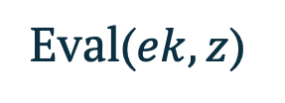
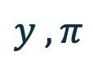
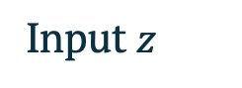
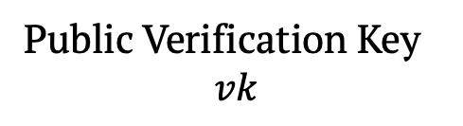
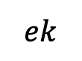
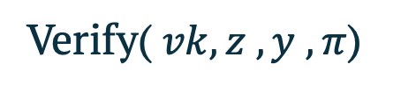
Verifiable Random functions (VRFs)
Input $z$
Public Verification Key
$$vk$$
FuncSamp()
$$ek$$
Eval($ek,z$)
Verify($vk,z ,y , π$)
$$y , π$$
Valid!
Output distribution indistinguishable from random
Publicly verifiable evaluation proof
Notes:
Alright lets start with a high level overview of Verifiable random functions. We start with an algorithm FucnSamp, which stands for function sampling. This outputs an evaluation key ek, and a public vk. We can evaluate the function t any input z by running the Eval algorithm, which outputs y, the eval and a proof pi. Anyone can publicly verify that y is the right eval by running the Vf algo with vk,z,y and pi.
The 2 key properties of vRFs, are, as the name suggests, 1. , 2.

Slide 5
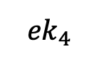
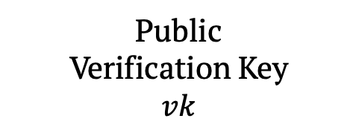
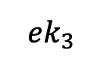
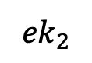
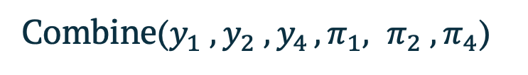
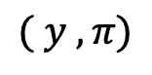
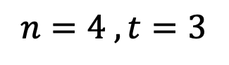
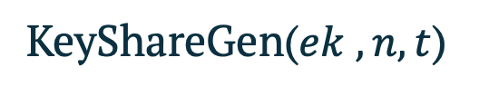
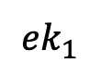
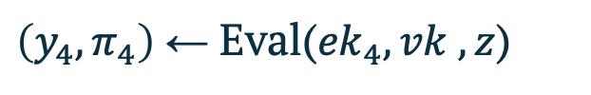
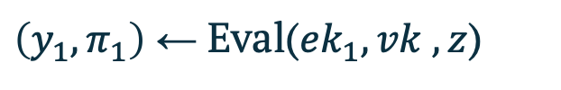
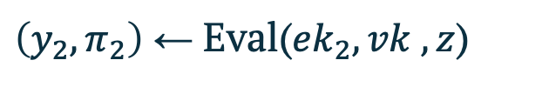
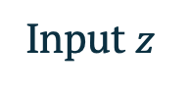
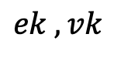
Threshold Verifiable Random Functions (VRFs)
$$n=4 , t=3$$
Input $z$
FuncSamp()
$$ek , vk$$
Public
Verification Key
$$vk$$
KeyShareGen($ek , n,t$)
$$ek_{1}$$
$${ek}_{2}$$
$${ek}_{3}$$
$${ek}_{4}$$
$\left(y_{2},π_{2}\right)$ ← Eval(${ek}_{2}, vk , z$)
$\left(y_{1},π_{1}\right)$ ← Eval(${ek}_{1}, vk , z$)
$\left(y_{4},π_{4}\right)$ ← Eval(${ek}_{4}, vk , z$)
Combine($y_{1} , y_{2} , y_{4 }, π_{1}, π_{2} , π_{4}$)
$$( y , π)$$
Notes:
In our work, we focus on threshold VRFs, at a high level, the ek is distributed among many parties for better fault tolerance. In our example here, we have n=4 parties and t=3.
We have an algo KeyShareGen which outputs the ek shares of all parties, ek1 to ekn.
Then, to evaluate the func at any input z, we can send it to any 3 parties, lets say parties 1,2 and 4, they each run the Eval algo to get one share of the eval along with a proof.
The 3 shares can then be combined using the Combine algo, to get the full eval y and a proof pi.

Slide 6
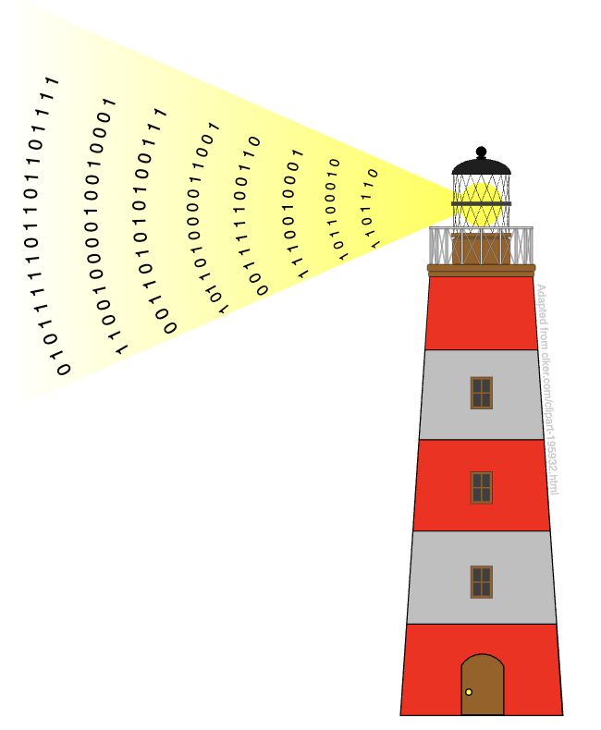

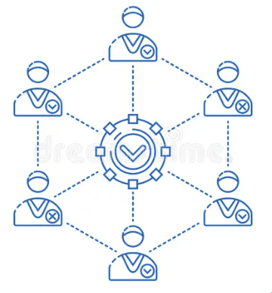

Applications of Threshold VRFs
Distributed
Randomness beacons
Deterministic Wallets
Consensus
Games
Notes:
Threshold VRFs are being used in a lot of applications, the two big ones are
1. Dist Rand Beacons, further used in consensus and on-chain apps like poker.
2. Also in deter wallets, for doing key derivation.

Slide 7
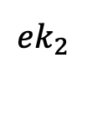
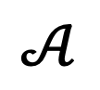
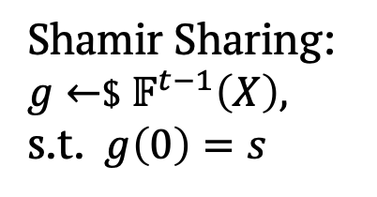
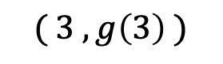
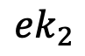
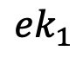
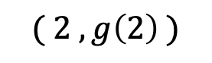
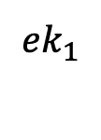
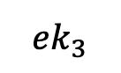
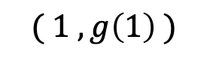
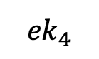
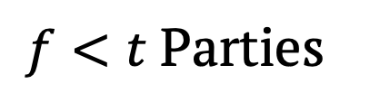
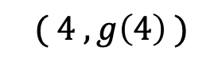
Traceability in VRFs: Motivation
What if an adversary $𝒜$offers to buy the evaluation key shares of some parties?
Shamir Sharing:
$g←$$ $𝔽^{t−1}\left(X\right),$
s.t. $g\left(0\right)=s$
$$ek_{1}$$
$${ek}_{2}$$
$${ek}_{3}$$
$${ek}_{4}$$
$${ek}_{1}$$
$${ek}_{2}$$
$$( 1 , g\left(1\right) )$$
$$( 2 , g\left(2\right) )$$
$$( 3 , g\left(3\right) )$$
$$( 4 , g\left(4\right) )$$
$f<t$ Parties
$$𝒜$$
Evaluation key shares could trivially identify the selling parties
Notes:
To motivate traceability, as we saw before, the question we ask is, what if an adv offers to buy the evaluation key shares of some parties? In our example here, lets say parties 1 and 2 sell their eval shares in exchange for money. Here f is the number of parties who sell their shares, and we assume f is less than t.
In such a scenario, If a whistleblower releases these leaked shares, then We would like to have some mechanism to hold the parties accountable for this leakage.
But in this simple example, where the parties simply gives their share to the adv, if this share is leaked, the we can trivially identify the selling party.
E.g. lets consider shamir secret sharing, this is the most commonly used method of sharing a secret. Here, we sample a rand poly g of deg t-1, and we set g(0) to be the secret value s. then, each party gets one point on this polynomial. E.g. key share of party1 would be (1,g(1)) and the share of party 2 would be (2,g(2)) – becase the polynomial is of deg t-1, any t points are enough to completely determine the polynomial. Back to this example, lets see what happens if the parties just directly give their shares to the adv. Now if a whistleblower tells us that (1,g(1)) was leaked, we already know that party 1 sold its share!
But, this does not mean that we are done, because the parties can do something smarter:

Slide 8
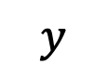
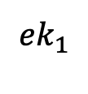
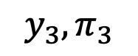

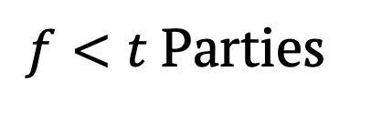
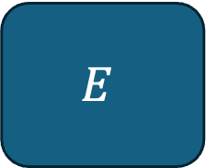
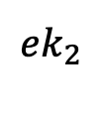
Traceability in VRFs: Motivation
What if an adversary $𝒜$offers to buy the evaluation key shares of some parties?
$$ek_{1}$$
$${ek}_{2}$$
$${ek}_{3}$$
$${ek}_{4}$$
$$𝒜$$
$f<t$ Parties
$$E$$
$$z$$
Goal:
A tracer can trace this box to the parties who “manufactured” it
$$y$$
$$y_{3}, π_{3}$$
Stateless algorithm
Notes:
For example, parties 1 and 2 can cloak their secret shares and give an evaluation box to the adversary. e.g. they can use obfuscation. This box is a stateless algorithm, it takes as input a value z at which you want to evaluate the function, and t-f evaluation shares for this input, e.g. here, we are giving it one evaluation share, w.r.t. the 3rd party, so we give y3,pi3 as input, and this box then outputs the full VRF evaluation y at z.
In such a scenario, the goal is that a tracer can trace this box to the parties who manufactured it.

Slide 9
Traceability is needed in many applications of VRFs
Distributed
Randomness beacons
Deterministic Wallets
Consensus
Games
Notes:
This notion of traceability is important in all the applications:
e.g. beacons used in online games, like poker. Now if one of the players uses this box to see future randomness values, it can essentially win the game everytime!!

Slide 10
This work: Traceable VRFs
Define traceability for threshold VRFs
Construction from Paillier encryption
Notes:
So in this work,
We Define,
And we give the 1st const of traceable VRF.
Lets get started with the defns.

Slide 11


Defining Traceable VRFs
FuncSamp($n , t$) $→\left( ek , vk , ρ , tk_{0} \right)$
KeyShareGen($ek , n , t , ρ ;r_{i}$) $→( ek_{i} , tk_{i} )$
Eval($ek_{i} , vk , z$) $→ y_{i} , π_{i}$
EvalVerify($vk , z , y_{i} , π_{i}$) $→ b_{i}$ // $b_{i}∈\{0,1\}$
Correlation string
e.g. $g∈𝔽^{t−1}\left(X\right)$ for Shamir
Notes:
Lets start with the syntax.
As we briefly saw before, we have a FuncSamp algo which samples the ek for the func, along with vk. It outputs 2 other things, a tracing key component tk0 and a string rho, which we call a correlation string. E.g. for shamir, you can think of this as the polynomial g of deg t-1.
Then, we have a KyeShareGen algorithm to generate shares of the ek. Note that we make a slight modification to the usual syntax: the KeyShareGen algorithm produces one key share at a time. So to get the shares for all n parties, we call KeyShareGen n times.
The inputs to KeyShareGen are n, the number of parties, t, the threshold, then ek which is the key.
We have two additional inputs: first, we have randomness ri for the ith share, and rho which is the correlation string
The output of KeyShareGen includes one key share, along with one component of the tracing key.

Slide 12





Defining Traceable VRFs
Combine(${ y}_{i_{1}}, …, y_{i_{t}} , π_{i_{1}} , …π_{i_{t}}$) $→ y , π$
Verify($vk , z , y , π$) $→ b$ // $b∈\{0,1\}$
${Trace}^{E\left(⋅\right)}(tk)$ $→ \hat{𝒥}⊆[n]$
$$E$$
Input $z$
$$y$$
$t−f$ Evaluation shares
$${\left\{ y_{i} , π_{i} \right\}}_{i ∈[t−f]}$$
Notes:
Next, we have Eval: each party can use its key share to get one share of the func eval at z, alongwith a Proof pi_i.
EvalVf: can be used to check whether the eval share y_i and the proof pi I is valid for input z.
Then we have Combine: used to combine any t eval shares and their proofs, to get a full evaluation y and its proof pi.
Vf: to check whether y, pi are valid.
Lastly, we have Trace: run by the tracer. This takes as input the tk, and BB access to an eval box E. just as a reminder, box E has f key shares in it, and it takes as input z, and t-f eval shares at z, outputs the func eval y at z.

Slide 13










Defining Traceable VRFs
FuncSamp() $→\left( ek , vk , ρ , tk_{0} \right)$
KeyShareGen($ek , n , t , ρ ;r$) $→( ek_{i} , tk_{i} )$
e.g. Shamir:
$n , t$ , $ek$ : Key
$ρ$ : Correlation String
$r_{1}$: Randomness
KeyShareGen
$$g$$
$$ek_{1} , tk_{1}$$
$$g(r_{1})$$
$$tk={(tk_{0} , \left\{ tk_{i} \right\}}_{ i ∈ [n]})$$
$n , t$ , $s$ : Secret
$ρ$ : Correlation String
$r_{n}$: Randomness
KeyShareGen
$$g$$
$$ek_{n} , tk_{n}$$
$$g(r_{n})$$
Notes:
As we briefly saw before, we have a FuncSamp algo which samples the ek for the func, along with vk. It outputs 2 other things, a tracing key tk0 and a string rho (We’ll see what this is in a minute).
Then, we have a KyeShareGen algorithm to generate shares of the ek. Note that we make a slight modification to the usual syntax: the KeyShareGen algorithm produces one key share at a time. So to get the shares for all n parties, we call KeyShareGen n times.
The inputs to KeyShareGen are n, the number of parties, t, the threshold, then ek which is the key.
We have two additional inputs: first, we have randomness ri for the ith share,
and second, because we are now generating shares one at a time, we need something to capture the correlation between all the different shares. So we have rho as an additional input: we call it a correlation string,
Lastly, The output of KeyShareGen includes one key share, along with one component of the tracing key. For example in shamir secret sharing, you can think of rho as the coefficients of the random polynomial g, the randomness r1 would just be 1, and the key share ek1 would be g(1). We then run KeyShareGen for each party, so for the nth party, we’ll use rn = n, and we’ll get ekn which will be equal to g(n) for shamir.
Lastly, we’ll get the full tk as the list of tki and tk0.

Slide 14

Defining Traceable VRFs
Eval($ek_{i} , vk , z$) $→ y_{i} , π_{i}$
EvalVerify($vk , z , y_{i} , π_{i}$) $→ b_{i}$ // $b_{i}∈\{0,1\}$
Combine(${ y}_{i_{1}}, …, y_{i_{t}} , π_{i_{1}} , …π_{i_{t}}$) $→ y , π$
Verify($vk , z , y , π$) $→ b$ // $b∈\{0,1\}$
${Trace}^{E\left(⋅\right)}(tk)$ $→ \hat{𝒥}⊆[n]$
$$E$$
Input $z$
$$y$$
$t−f$ Evaluation shares
$${\left\{ y_{i} , π_{i} \right\}}_{i ∈[t−f]}$$
Notes:
Next, we have Eval: each party can use its key share to get one share of the func eval at z, alongwith a Proof pi_i.
EvalVf: can be used to check whether the eval share y_i and the proof pi I is valid for input z.
Then we have Combine: used to combine any t eval shares and their proofs, to get a full evaluation y and its proof pi.
Vf: to check whether y, pi are valid.
Lastly, we have Trace: run by the tracer. This takes as input the tk, and BB access to an eval box E. just as a reminder, box E has f key shares in it, and it takes as input z, and t-f eval shares at z, outputs the func eval y at z.

Slide 15

Defining Traceable VRFs
Correctness:
Combining honest evaluation shares of any coalition of size $t$ gives the right function evaluation.
Uniqueness:
For every input, there is only one evaluation that passes verification.
Pesudorandomness:
An adversary with $t−1$ keys and evaluations on inputs of its choice, cannot distinguish evaluation of a new input from random.
Notes:
Now that we’ve seen the syntax, lets look at the security properties for traceable VRFs. 1. correctness, usual notion, …
2. uniqueness, 3. pseudorand: …
I wont be covering the formal defns today.

Slide 16

Defining Traceable VRFs
Traceability:
$Trace$ traces $E$ to $f$ parties who “manufactured” it.
Tracer Uniqueness:
Malicious tracer cannot produce two valid evaluations for a single input.
Tracer Pseudorandomness:
Malicious tracer cannot distinguish evaluation of a new input from random, even with $t−1$ keys and evaluations on inputs of its choice.
Notes:
Next, because we’re defining traceable VRFs, we define a notion of traceability, which says that the tracer can …
We define additional properties to ensure tracer doesn’t have too much power,
Tracer Uniq: even tracer cant produce ..
Tracer pseudorand: … for today’s talk, I’ll only be focusing on traceability.

Slide 17
Traceability for Traceable Verifiable Random Functions
Two notions:
One-time
Many-time (stronger)
Notes:
Now lets see formal defn for traceability. We actually define 2 notions, which we call one-time and many-time. We’ll start with looking at one-time traceability.

Slide 18



Traceability for Traceable Verifiable Random Functions
$Trace$ traces $E$ to the parties who “manufactured” it.
$$ek_{1}$$
$${ek}_{2}$$
$${ek}_{3}$$
$${ek}_{4}$$
$$𝒥=\{1 , 2\}$$
$\left|𝒥\right|=f<t$Sellers
Goal:
$$E$$
If $E$ is “good” then,
All $f$ sellers found
No honest party blamed
$\hat{𝒥 }=Trace^{E}( tk )$
Notes:
So at a high level, we want that the tracer traces an eval box to the f parties who manufactured it.
So back to our example with 4 parties, where the first 2 parties combine their shares to make an eval box E. so J denotes the set of selling parties is 1,2, and f is the size of J, is 2 in this example. Then, We run the Trace algorithm on this box to get a set Jhat. Then what we want is that, if the box E is good, which I wil formally define later, then, the Trace algorithm should find all f sellers. Additionally, we should not blame an honest party.

Slide 19








Traceability for Traceable VRFs: One-time
Challenger
Adversary
$$n , t ,ℐ$$
$$ek , vk , tk_{0}, ρ←FuncSamp() , f←|ℐ|$$
$∀ i∈\left[n\right], tk_{i} , ek_{i}$ ←$ KeyShareGen($ek,n , t , ρ$)
$$tk←tk_{0} , \{tk_{i}\}$$
$${\left\{ {ek}_{i} \right\}}_{i ∈ ℐ} , vk$$
$E$
$ℐ^{′} ←$$ ${ Trace}^{ E(·)} \left( tk\right)$
Adv wins if:
1. AND 2. $ℐ^{′}≠ℐ$
$E$ is “good” w.r.t.
$$n,t,f,ek,vk,ρ , ε,δ$$
Honest party blamed OR some seller not found
Notes:
Here’s the formal game based definition to capture this notion. So we have a Chal on the left and the adv on the right, the game starts with the adv sending n, the #parties, t: the threshold and J, the set of parties it wants to corrupt, to the chal. The chal then samples a random eval key ek, and a correlation string rho by running FuncSamp. Then it runs the KeyShareGen algorithm n times to get key shares ek1 to ekn, along with the tracing keys. The chal then sends the shares of all the corrupt parties to the adv. The adv then gives us an eval box E, and the chal runs Trace on it to get a set J’.
Note that This is private tracing, we do not give the tracing key to the adv. But in our constructions, tk does not allow breaking uniqueness or pseudorandomness.
Ok, so we say that the adv wins this game if first, box E is good. We formally define this by saying that there is a subset of inputs, denoted by ZE here, .t. for all inputs in this set, the box outputs the correct evaluation with probability epsilon. Here, the box is run with t-f evaluation shares of z, generated using t-f random key shares.
So that’s the formal notion of the box being good, so the adv wins if the box is good as per this definition, but, J’ is not equal to J, meaning that we are either blaming an honest party or we did not catch all the sellers.

Slide 20
Traceability for Traceable VRFs: One-time
Defn. A Traceable VRF scheme is one-time traceable if no efficient adversary can win the above game with non-negligible probability.
Notes:
We say that a VRF scheme is one-time-traceable if no efficient adversary can win the above game with non negl prob.

Slide 21





Traceability for Traceable VRFs: Many-time
Challenger
Adversary
$$n , t ,ℐ$$
$$ek , vk , tk^{∗}, ρ←FuncSamp\left(\right) , f←|ℐ|$$
$∀ i∈\left[n\right], tk_{i} , ek_{i}$ ←$ KeyShareGen($ek,n , t , ρ$)
$$tk←tk^{∗} , \{tk_{i}\}$$
$${\left\{ {ek}_{i} \right\}}_{i ∈ ℐ} , vk$$
EvalOracle($i, z$)
Evaluation share oracle
Eval($ek_{i} , vk , z$)
$E$
$ℐ^{′} ←$$ ${ Trace}^{ E(·)} \left( tk\right)$
Adv wins if:
$E$ is “good” w.r.t.
$$n,t,f,ek,vk,ρ , ε,δ$$
Honest party blamed OR All sellers not found
Notes:
Now lets take a quick look at the many time traceability notion, which is stronger than one-time.
The game remains pretty much the Same as before, the only difference is : adv can query partial evaluations, so it can query Eval at any input z, for any party i. and the chal responds with the corresponding eval share.
As u might imagine, This is more realistic, cuz in the real world: the corrupt parties can see as many evaluations as they like, before they sell their shares.
That’s where the name comes from: MANY TIME means the VRF can be evaluated multiple times before we get the box.

Slide 22
Traceability for Traceable VRFs: Many-time
Defn. A Traceable VRF scheme is many-time traceable if no efficient adversary can win the above game with non-negligible probability.
*We will focus on one-time traceability in this talk.
Notes:
As before, We say that a VRF scheme is many-time-traceable if no efficient adversary can win the above game with non negl prob.

Slide 23
This work: Traceable VRFs
Define traceability for threshold VRFs
Construction from Paillier encryption
Notes:
Define, 1st const of traceable VRF.

Slide 24









Standard Threshold VRFs are not traceable
$g$: random polynomial of degree $t−1$ s.t. $g\left(0\right)=ek$
$${ek}_{1}=( 1 , g\left(1\right) )$$
$${ek}_{2}=( 2 , g\left(2\right) )$$
$${ek}_{3}=( 3 , g\left(3\right) )$$
$${ek}_{4}=( 4 , g\left(4\right) )$$
Shares in the box: $𝒥$
$$\left|𝒥\right|=f<t$$
If $T∩𝒥≠φ$ :
Output $⊥$
Otherwise:
Output Combine(${\left\{Eval({ek}_{i} , vk , z)\right\}}_{i∈𝒥} , {\left\{ \left( i,y_{i} \right) \right\}}_{i ∈ T}$ )
Input $z$
Shares as input: $T$
$${\left\{ \left(i ,y_{i}\right)\right\}}_{i ∈ T}$$
Notes:
Before we see our construction, I wanna first explain why its non trivial. Specifically, standard threshold VRFs are actually not traceable. To explain that lets use our example of 4 parties, out of which the 1st two combine their shares and make a box which takes z and t-f eval shares as input, here f is the number of sellers which is 2 in this example.
lets denote the set of input eval shares as T. Now lets consider a specific box, which has the following logic: it checks whether T contains a corrupt party’s share, specifically if T intersection with J is not empty, and if that’s the case, the box simply outputs bot. Otherwise, it gives us the correct eval by running Combine over the input shares and eval shares from key shares in the box.
Basically the box only works if we give it t-f eval shares from honest parties.

Slide 25






Standard Threshold VRFs are not traceable
Probability that the tracer gets $E$ to output not $⊥$ :
Choose any $t−f$ parties from $n−f$ parties not in $𝒥$
Choose any $t−f$ parties from $[n]$
For $t= \frac{2n}{3}$ and $f=\frac{n}{3} ,$ this is Negligible
⇒ Tracer cannot get box E to work
Notes:
But we cannot actually trace such a box.
the problem is that we don’t know who the honest parties are, so the best the tracer can do is to give evaluation shares of random parties as input to his box.
this means, that the probability that the tracer can get the box to output something meaningful is n-f choose t-f / n choose t-f. numerator denotes choosing t-f honest parties , and the denominator denotes choosing any t-f parties. This value is actually negligible for most values of t,f. for example, for t = 2n/3 and f = n/3,
In summary, if we use shamir secret sharing to share the eval key, the parties could make such a box, and then the tracer would need an exponential number of queries to this box to learn anything meaningful.
// this probability is a small constant times 0.84^n, which is negligible!

Slide 26
One-time Paillier-based Traceable VRF: Building Blocks
Shamir-based Traceable Secret Sharing [BPR24]
+
Paillier-based VRF
Notes:
That’s why in our work we use a traceable secret sharing scheme to share the ek. Specifically, we use a shamir-based scheme from this 2024 paper. Now I’ll briefly describe how they get around this impossibility.

Slide 27








Shamir-based Traceable Secret Sharing [BPR24]
$g$: random polynomial of degree $t−1$ s.t. $g\left(0\right)=ek$
Sample $x_{1}, …,x_{n} ←$$ $𝔽$ // $\left| 𝔽 \right|>superpoly(n)$
$${ek}_{1}=( x_{1} , g\left(x_{1}\right) )$$
$${ek}_{2}=( x_{2} , g\left(x_{2}\right) )$$
$${ek}_{3}=( x_{3} , g\left(x_{3}\right) )$$
$${ek}_{4}=( x_{4} , g\left(x_{4}\right) )$$
If $T∩𝒥≠φ$ :
Output $⊥$
Otherwise:
Output Combine(${\left\{Eval({ek}_{i} , vk , z)\right\}}_{i∈𝒥} , {\left\{ \left( i,y_{i} \right) \right\}}_{i ∈ T}$ )
$E$ cannot link $(x_{i},y_{i})$ to party $i$
Input $z$
Shares as input: $T$
$${\left\{ \left(x_{i} ,y_{i}\right)\right\}}_{i ∈ T}$$
Notes:
they slightly modify shamir secret sharing -- to share a secret, which is the ek for us, we sample a random polynomial g of degree t-1 s.t. g(0)=ek, but additionally, we also sample x1,x2.... xn from the field F.
then, for party 1, instead of evaluating g at 1, we evaluate it at x1. more formally, share of party1 would be the tuple x1,g(x1), similarly sh2 would be x2,g(x2), and so on. lets see why this solves the problem:
we consider the same box as before, the inputs to this box would now be the tuple (xi, g(xi)). the inputs to this box would now be the tuple (xi, g(xi)). but the main thing is that the tracer can now run the box with random xi values because the box cannot identify which party does this share correspond to.

Slide 28













Shamir-based Traceable Secret Sharing [BPR24]
$g$: random polynomial of degree $t−1$ s.t. $g\left(0\right)=s$
$t$-out-of-$n$ Secret sharing of $s$
Sample $x_{1}, …,x_{n} ←$$ $𝔽$
// $\left| 𝔽 \right|>superpoly(n)$
$$sh_{1}=( x_{1} , g\left(x_{1}\right) )$$
$$sh_{2}=( x_{2} , g\left(x_{2}\right) )$$
$$sh_{3}=( x_{3} , g\left(x_{3}\right) )$$
$$sh_{4}=( x_{4} , g\left(x_{4}\right) )$$
$f<t$ Sellers
$$𝒜$$
$$R$$
$$Trace^{R}$$
$$sh_{3}$$
$$s$$
1,2
Notes:
With this change, the TSS scheme actually achieves traceabiliity, similar to our definition. Specifically, they consider the case where some f < t parties holding secret shares sell a recon box, this box takes t-f secret shares as input, and outputs the reconstructed secret s. their TSS scheme has a trace algo, which given this box, outputs all the f parties who sold their shares, which is {1,2} in this example. I wont go into the more details.

Slide 29
But, Traceable Secret Sharing is not enough
Can’t we just use Traceable Secret sharing [BPR24] to split the evaluation key for any VRF?
Traceable Secret sharing [BPR24] only traces boxes which output the full secret!
Notes:
But now U might be wondering, if we have a traceable SS, then cant we simply get a traceable VRF if we just use traceable SS to split the evaluation key among the parties?
Unfortunately, the TSS scheme that we just saw only traces boxes which output the full secret!
But in our case, we get an evaluation box, which only gives us VRF evaluations at arbitrary inputs. So, we have to do something non trivial to be able to trace such boxes.

Slide 30
One-time Paillier-based Traceable VRF: Building Blocks
Shamir-based Traceable Secret Sharing [BPR24]
+
Paillier-based VRF
Notes:
This brings us to the 2nd building block of our const, which is paillier based VRF.

Slide 31


Paillier Encryption
Paillier Encryption!
Need encryption with:
Additively homomorphic Encryption
Sampleable Ciphertext
Ciphertext Space : $ℤ_{N^{2}}$ where $N=pq$ and $p,q$ are safe primes
$(1+N)$ generates a subgroup with easy Discrete log $mod{ ℤ}_{N^{2}}$
Notes:
Lets start with paillier encryption. At a high level, we need an enc with 2 key properties. 1. additively homomorphic, 2. its ciphertext space should be sampleable.
Turns out paillier satisfies both of these, CT space is just ZN^2, where N is an RSA modulus, with p,q being safe primes.
so to sample a CT, we can just sample any element mod N^2.
Another key property of Paillier is that the element 1+N generates a subgroup of ZN2 where DL is easy!!
We’ll now see how these properties are crucial to our construction.

Slide 32


Paillier Encryption
Public key: RSA Modulus $N=p⋅q$ where $p,q$ are safe primes
Secret key: $φ\left(N\right)=(p−1)(q−1)$
Encrypt($N , m∈ℤ_{N}$) :
Sample $r←$$ $ℤ_{N}$
Output ${\left(1+N\right)}^{m}⋅r^{N} mod N^{2}$
Decrypt($φ\left(N\right), c$) :
Output $\frac{L_{N}\left(c^{φ\left(N\right)}\right)}{φ(N)}=\frac{c^{φ\left(N\right)} − 1 mod N^{2}}{φ\left(N\right)N}$
Additively homomorphic Encryption
Sampleable Ciphertext
(Each element in $ℤ_{N^{2}}$ is a valid ciphertext)
Notes:
I’ll first start with a quick overview of paillier encryption. So here the public key is an RSA modulus, N product of two safe primes. Sk is phi(N), similar to RSA.
To encrypt a msg : msg space is ZN, we sample r uniformly from ZN, and then we compute (1+N) to power m times r^N mod N^2. Here, 1+N is the generator of a subgroup with easy DL. And r can be thought of as the blinding factor.
To decrypt: we essentially wanna get rid of the r term so we can take discrete log. Formally, we raise ct to power phi(N). This gets rid of the r term, then to get Dlog, we evaluate LN of c^phi, expanding this, we simply subtract 1 and divide by N times phi(N).
Two key proeprties of paillier that I wanna highlight are 1. additively homomorphic enc, if u multiply 2 CTs, u get enc of m1+m2. 2. it has sampleable CT space, what I mean by that is that each element iin ZN^2, is a valid CT.
We’ll see why these 2 properties are helpful for our construction.

Slide 33



Paillier-based VRF [eVRF:BHL24]
Verification key: RSA Modulus $N=pq$ where $p=2p^{′}+1 , q=2q^{′}+1$
Evaluation key: $φ\left(N\right)=4p^{′}q′$
Eval($ek , vk , z$):
Let $c=H\left(z\right)$ , where $H :\text{𝒵}\text{ → }ℤ_{N^{2}}$
Output $y=DLog \left(c^{φ\left(N\right)}\right)∈ℤ_{N^{}}$
$$QR_{N^{2}}$$
, $π=$NIZK Proof of DLog Equality in $QR_{N^{2}}$
Notes:
Now, lets see how we can use pailier enc to construct a VRF. This was formally specified in the eVRF paper by boneh et al in 2024.
In one line, This is essentially a full domain hash over the ciphertext space. More formally, the vk will be an RSA modulus N (p,q are safe primes: so p=2p’+1, where p’ is prime, same for q), vk is N, ek is phi(N).
Then, to evaluate the VRF at any input z, we hash z into the CT space, which is ZN^2, note we can do this because CT space is sampleable.
Then, the eval is just the dec of this CT. formally, this is LN (c^phiN).
To prove the evaluation of this VRF, we want a NIZK proof of Discrete log equality, to prove that we raised CT to the right power.
Turns out, because paillier is additively homomorphic, we can use very simple sigma protocols when working in the group of quadratic residues modulo N^2, so we just restrict the hash to that group.

Slide 34


Paillier-based VRF + Traceable Shamir
FuncSamp( $n ,t$ ):
Sample RSA modulus $N=pq$ where $p=2p^{′}+1 , q=2q^{′}+1$
Sample $g\left(x\right)=Σ_{i=0}^{t−1} g_{i} x^{i}$ s.t. $g\left(0\right)=p^{′}q′$
Sample $v∈QR_{N^{2}}$
Output $ek=p^{′}q^{′}$ , $vk=(N , v , v^{g_{0}} , …, v^{g_{t−1}})$
Can compute $v^{g(x)}$ for any $x∈ℤ_{N}$
Notes:
Now, lets start with our paillier based traceable threshold VRF construction.
Starting with FucnSamp,
For the proofs, we samples a random element v in QR mod N^2, and now the ek is same as before
But vk contains N, along with v, and v^g0…. V^gt-1. this is the setup for the evaluation proofs. one key thing to remember about this setup is that we can use these terms to compute v^g(x) for any x, we’ll see how this is useful in a bit.

Slide 35







Paillier-based VRF + Traceable Shamir
KeyShareGen($ek=p^{′}q′ , n , t , ρ$):
Parse $ρ$ as $g∈ ℤ_{Np^{′}q′}^{t−1}[X]$ s.t. $g\left(0\right)=p^{′}q′$
Sample $x_{i}←$$ $ℤ_{N}$
Set $tk_{i}←x_{i}$
$t$-out-of-$n$ Traceable Secret sharing of $p^{′}q′$
$${ek}_{1}=( x_{1} , g\left(x_{1}\right) )$$
$${ek}_{2}=( x_{2} , g\left(x_{2}\right) )$$
$${ek}_{3}=( x_{3} , g\left(x_{3}\right) )$$
$${ek}_{4}=( x_{4} , g\left(x_{4}\right) )$$
Eval($ek_{i} , vk , z$): return $y_{i}$ ← $\left(x_{i} , {\hat{y}}_{i}= H{\left(z\right)}^{g\left(x_{i}\right)}\right)$
and $π_{i}←$NIZK Proof of DLog Equality in $QR_{N^{2}}$ for
( $H\left(z\right) , {\hat{y}}_{i} , v , v^{g(x_{i})}$ )
EvalVerify($vk , z , y_{i} , π_{i}$): Verify $π_{i}$
Notes:
Now we’ll see our construction PTV, stands for traceable paillier based VRF. As I showed before,
We’ll Use traceable shamir to secret share the evaluation key. KeyShareGen: poly over Z_Np’q’, this is not prime, but a product of 4 prime groups, so everything works pretty much the same as usual.
Ok so for party 1, we sample x1 uniformly from ZN, then party1 gets x1 and eval of g at x1, similarly for all other parties.
To Eval a share: party I hashes the input z, then raises to power g(xi). Additionally, to prove that this is a valid share, it also computes a proof of DL equality, for this tuple: H(z) and yi hat, and also v, v^g(xi) : recall we can compute this from the terms in the vk.

Slide 36

Paillier-based VRF + Traceable Shamir
Combine($y_{1}, …, y_{t} , π_{1} , …, π_{t}$):
Compute $ν=\prod_{i,j∈\left[t\right], i<j}{(x_{i} −x_{j})}$
Compute $d←\prod_{\left\{i∈\left[t\right]\right\}}{{\hat{y}}_{i}^{{νλ}_{x_{i}}}}$
Set $π←({ π}_{1} , …, π_{t} )$
Return $\frac{DLog\left(d\right)}{ν} , π$
Notes:
Combine: as u might expect, we do lagrange interpolation in the exponent. So we’ll raise yi to power lambda_i which is lagrange coeff for xi.
But we need to be careful because lambda_xi, but this has denominators: in ZN^2: because it’s a group of unknown order, we cannot compute roots.
So, we compute nu first which is the product of all the denominator terms.
Then we raise yi_hat to nu times lambda_xi, so there’s no denominators.
Lastly, we do LN(d) and then divide by nu to get rid of this extra factor

Slide 37
One-time Paillier-based Traceable VRF
Correctness
Uniqueness
Pseudorandomness
Traceability
Notes:
Ok so we’ve seen the VRF Eval and Combine functions, correctness is trivial. Uniqueness is also straightforward because we’re essentially decrypting a CT, so there can only be one unique decryption.
Pseudorand: prove this based on SS of paillier
Next, lets see how we can trace an eval box in our construction.

Slide 38











Paillier-based VRF + Traceable Shamir: Trace
$$n=4 , t=3 , f=2$$
$${ek}_{1}=( x_{1} , w_{1} )$$
$${ek}_{2}=( x_{2} , w_{2})$$
$${ek}_{3}=( x_{3} , w_{3} )$$
$${ek}_{4}=( x_{4} , w_{4} )$$
$$E$$
$$z$$
Let’s assume $E$ is ‘perfect’ for now
i.e. $ε=δ=1$
$$y^{∗}$$
$$x , H{\left(z\right)}^{g(x)}$$
$E$ is “good” $⟹$
$$\operatorname{Pr}\left[y^{∗}=\frac{DLog\left( H{\left(z\right)}^{g\left(x\right)νλ_{x_{}}^{\left\{x, x_{1}, { x}_{2}\right\}}}⋅H{\left(z\right)}^{w_{1}⋅νλ_{x_{1}}^{\left\{x, x_{1}, { x}_{2}\right\}}}⋅H{\left(z\right)}^{w_{2}⋅{νλ}_{x_{2}}^{\left\{x, x_{1}, { x}_{2}\right\}}}\right)}{ν}\right]≥εδ$$
Notes:
For that, lets look at the eval box in more detail: recall that we said that a box E is good if it can give the correct eval at z given enough eval shares. For this example where the box has two key shares, and the threshold is 3, the box will take in one more eval share as input along with z, lets say (x, H(z)^g(x)) and it will output the full evaluation y*. But what is this y*? If the box E is good with respect to epsilon-delta, then this implies that y* is equal to LN of lagrange interpolation of the input share with eval shares from ek1,ek2 with probability epsilon*delta. More formally, the y* is equal to LN of H(z) to power g(x)*nu*lambda_x + w1 times nu times lambda x1 + w2 times nu times lambda x2 with probability epsilon*delta. For now, lets assume that epsilon and delta are 1, i.e. E is a perfect box.

Slide 39










Paillier-based VRF + Traceable Shamir: Trace
$$E$$
E is “perfect” $⟹$
$$y^{∗}=\frac{DLog\left({\left(H{\left(z\right)}^{g\left(x\right)}\right)}^{{νλ}_{x}^{\left\{x , x_{1},{ x}_{2}\right\}}}⋅H{\left(z\right)}^{w_{1}⋅{νλ}_{x_{1}}^{\left\{x, x_{1}, { x}_{2}\right\}}}⋅H{\left(z\right)}^{w_{2}⋅{νλ}_{x_{2}}^{\left\{x, x_{1}, { x}_{2}\right\}}}\right)}{ν}$$
$$=\frac{DLog\left(H{\left(z\right)}^{νp^{′}q^{′}}\right)}{ν}$$
$$z$$
$$y^{∗}$$
$$x ,H{\left(z\right)}^{g(x)}$$
$$z$$
$$E$$
$$y_{1}^{∗}$$
$x ,H{\left(z\right)}^{g(x)}⋅(1+N)$
E is “perfect” $⟹$
$$y_{1}^{∗}=\frac{DLog\left({\left(H{\left(z\right)}^{g\left(x\right)}(1+N)\right)}^{{νλ}_{x}^{\left\{x , x_{1},{ x}_{2}\right\}}}⋅H{\left(z\right)}^{w_{1}⋅{νλ}_{x_{1}}^{\left\{x, x_{1}, { x}_{2}\right\}}}⋅H{\left(z\right)}^{w_{2}⋅{νλ}_{x_{2}}^{\left\{x, x_{1}, { x}_{2}\right\}}}\right)}{ν}$$
$=\frac{DLog\left(H{\left(z\right)}^{νp^{′}q^{′}}⋅{\left(1+N\right)}^{{νλ}_{x}^{\left\{x , x_{1},{ x}_{2}\right\}}}\right)}{ν}=y^{∗}+λ_{x}^{\{x,x_{1},x_{2}\}}$
Notes:
So if the box is perfect, y* is equal to the interpolation in the exponent, I’m simplifying it here: we’ll get H(z) to power nu times g(0) which is p’q’. And then we get the DL.
Now, lets run the box with slightly different input: we run it with the same z, same x, but I change the eval share to H(z)^g(x) * (1+N). lets say the box outputs y1*. Now again because the box is perfect, y1* must be the LN of interpolation of this share with shares of ek1 and ek2. more formally, y1* must be H(z)^g(x) times nu times lambda_x multiplied with (1+N)^nu times lambda_x, and the other terms remain the same as before. I’ve simplified this again, we get LN of H(z)^nu times p’q’ mult by the (1+N) term. Recall 1+N generates a Dlog easy group, so
If we compare this to the above box, we see that y1* is basically equal to y* + lambda x.

Slide 40


Paillier-based VRF + Traceable Shamir: Trace
${ y_{1}^{∗} −y}^{∗} = \frac{x_{1}x_{2}}{(x_{1}− x)(x_{2} − x)} mod N$
$⇒{\left({y_{1}^{∗} − y}^{∗}\right)}^{−1}= \frac{(x_{1} − x)(x_{2}−x)}{x_{1}x_{2}}$
${Trace}^{R}\left( tk={\left\{{ x}_{i} \right\}}_{i∈\left[n\right]} \right):$
Get evaluation of $h(Y)$ at $f$ different values of $x$ → interpolate $h\left(Y\right) mod N$
For each $i∈\left[n\right]$ if $h\left(x_{i}\right)=0$ then set $\hat{𝒥} ←\hat{𝒥}∪\{ i \}$
Evaluation of $h\left(Y\right)=\prod_{ k ∈ 𝒥}{\frac{x_{k} − Y}{x_{k}}}$ at $x$
$h$ : degree $f$ polynomial
Roots : ${\left\{ x_{k} \right\}}_{k ∈ 𝒥}$
Notes:
Now, I’ll expand lambda x, so we get y1* - y* is equal to x1x2 divided by x1-x times x2-x mod N. If we invert this, we get that y1*-y* inverse is equal to x1-x times x2-x divided by x1x2. ok lemme now define a polynomial h(Y) as the product of xk – Y divided by xk for all corrupt parties in J.
So, basically, by running the box two times, we have found the evauation of h(Y) at Y = small x. Notice that this polynomial h is a degree f polynomial, where f is the number of sellers, and each of its roots correspond to a seller: so in our example, x1 and x2 are the roots of h(x) since parties 1 and 2 are corrupt.
We can exploit this fact to trace: first, we get evaluations of h(Y) at f different points, with these f evaluations, we can get interpolate to get all coefficients of h(Y). Then, for each party I, the tracer checks if xi is a root of this polynomial i.e. if h(xi) = 0, and this basically means that party i is bad. So we add i to Jhat, which is the set of parties to blame. And that’s it. We can trace a perfect box back to all the parties who manufactured it.

Slide 41










Tracing imperfect boxes
$$z$$
$$E$$
$$y^{∗}$$
$$x ,H{\left(z\right)}^{g(x)}$$
$${\left({y_{1}^{∗} − y}^{∗}\right)}^{−1}=h(x)$$
$$z$$
$$E$$
$$y_{1}^{∗}$$
$x ,H{\left(z\right)}^{g(x)}⋅(1+N)$
$y^{∗}$ or $y_{1}^{∗}$ may be wrong $⇒$
Evaluation $h(x)$ may be wrong
Notes:
But what about imperfect boxes?
Lets see why the tracing algorithm I just showed you cant work for imperfect boxes. So at a high level, we did 2 queries to the box, for an input z, and an x, with shares H(z)^g(x) andH(z)^g(x) times (1+N), and we got one evaluation of the polynomial h.
But the problem is that if E is imperfect, it may sometimes give you the wrong output, meaning, that y* or y1* may be wrong with some probabilitiy, also when I say wrong, I mean that the output wont be the correct evaluation that you would expect based on lagrange interpolation. And if y* or y1* is wrong, then the evaluation h(x) that we got may be wrong! So if we interpolate these wrong evaluations, we might get a polynomial completely different from h, and we might end up blaming honest parties!

Slide 42





Tracing imperfect boxes
Solution: List Decoding of Reed-Solomon Codes…
$L= (x^{\left(1\right)},z^{(1)})$ , $\left(x^{\left(2\right)},z^{\left(2\right)}\right)$, $\left(x^{\left(3\right)},z^{\left(3\right)}\right)$ , . . . , $(x^{\left(M\right)},z^{(M)} )$
$$f$$
$$C$$
$$D^{L}$$
Degree ( $h )=f$
$E$ is “good” $⇒$
$≥C$ evaluations are correct
So, $h∈P$
No known list decoding algorithm for polynomials over $ℤ_{N}$
$$P= g^{(1)} , { g}^{(2)} , …, g^{(y)}$$
All degree $f$ polynomials that agree with at least $C$ evaluations in $L$
Notes:
To solve this problem, we can use list decoding of reed Solomon codes. Lemme quickly explain what that is. Lets say we have a bunch of points : x1,z1, z2,z2 and so on till xM zM,
Then, list decoding is an algorithm that takes this list of points, along with parameters f and C, and it outputs all the polynomials, lets call them g1 to gy, s.t. they are of degree f, and they pass through at least C points in the list L. this is great because the polynomial that we want, h, also has degree f and because the box is good, h(x) does match up with many of the points in this list, so h does belong to this list P.
But there is one problem here, unfortunately, there is no known list dec algo for polys over ZN, or any groups of unknown order in general.
In one sentence: list decoding uses polynomial factorization, but there is no way to do that over ZN

Slide 43










Tracing imperfect boxes: List Decoding
e.g. $M=3 , f=1 , C=2 :$
$$g^{(3)}$$
$$g^{(1)}$$
For each point $(x^{(i)} , z^{(i)})$ , $g^{(j)}\left(x^{(i)}\right)=z^{(i)}$ for some $g^{(j)}∈P$
$$x^{(3)} , z^{(3)}$$
$$x^{(1)} , z^{(1)}$$
⟹ $Q\left(x,z\right)= \prod_{j∈[y]}{\left(z −g^{(j)}\left(x\right)\right)}$
is $0$ at all points $\left(x^{\left(i\right)} , z^{\left(i\right)}\right)$
$$x^{(2)} , z^{(2)}$$
$$g^{(2)}$$
$$P={\{ g}^{(1)} , g^{(2)} , g^{(3)} \}$$
Notes:
To solve this issue, lets now look at how list decoding works for reed Solomon codes. Lets consider this example, where we have three points x1z1… x3z3, lets say f=1 and C=2, i.e. we want deg 1 polys passing through atleast. 2points. Here, we have exactly three such polynomials g1,g2,g3.
The main observation used in list decoding is that for each point, lets say x1z1, there’s some polynomial in P s.t. this point lies on that polynomial. E.g. here, x1z1 lies on g1 and g2, i.e. g1 at x1 is z1, and so on.
An important implication of this fact is that if we define a bivariate poly, Q(x,z), which is the product of (z-gj(x)) for all gj polynomials in the list P, then this polynomial evaluates to 0 at all points!!! E.g. x1,z1: is on g1, means that z1 is equal to g1(x1), so Q will evaluate to 0, sim for all other points!!!

Slide 44


Tracing imperfect boxes: List Decoding
$L= (x^{\left(1\right)},z^{(1)})$ , $\left(x^{\left(2\right)},z^{\left(2\right)}\right)$, $\left(x^{\left(3\right)},z^{\left(3\right)}\right)$ , . . . , $(x^{\left(M\right)},z^{(M)} )$
1. Compute low-degree polynomial $Q\left(x,z\right)∈ ℤ_{N}[X,Z]$ s.t.
$Q\left(x^{(i)},z^{(i)}\right)=0 ∀ i∈[M]$ // $∀ g^{(j)}∈P$, $(z −g^{(j)}(x))$ divides $Q(x,z)$
2. Find all factors of $Q$ of the form $z−g^{(i)}(x)$ to get $P$
Notes:
So based on that observation, here’s the high level overview of list decoding for RS. Note there’s multiple algos for list decoding, but they all follow this blueprint.
Ok 1. we compute a low-deg bivariate Q, s.t. its 0 at all points. From the last slide, we know that this Q must have z-gj(x) as a factor for all polys gj in P.
So step2. we simply factor Q to get all the gj polynomials.
Now lets see what happens if we operate over ZN. 1st step: linear interpolation, we can do. But 2nd step: factoring polys is the problem – it involves non linear operations that cannot be done over a group of unknown order!!!

Slide 45



Tracing imperfect boxes: The solution
Degree ( $h )=f$
$E$ is “good” $⇒$
$≥C$ evaluations are correct
So, $h∈P$
Recall,
$h\left(X\right)=\prod_{i∈ 𝒥}{( x_{i} −X)}$
$Q\left(x, z\right)=\left(z −h\left(x\right)\right)⋅q(x,z)$
For each corrupt $i∈𝒥$,
$h\left(x_{i}\right)=0$
Consider
$Q\left(x_{i},z\right)=\left(z −0\right)⋅q(x,z)$
$Q\left(x_{i}, 0\right)=0$ for all corrupt parties $i$
Notes:
To solve this issue, the Key observation we make is that we don’t need full list decoding for our problem!!!
Lets see what I mean by that. Recall that the poly that we want, is h(X) which is equal to prod (xi-X) for corrupt parties i. As we also saw before, h(x) is in the list P because its degree is f, and because the box E is good, h does agree with many of the points in the list L. This means that z-h(x) must be a factor of Q.
Next, for each corrupt party I in J, we know xi is a root, in other words, h(xi)=0 for all corrupt i.
Now, lets consider Q(xi,z). This is equal to z times q(x,z). In other words, Q(xi,0) is 0 for all corrupt parties i!!
in our paper, we prove that this is not true for honest parties with high probability.
So this gives us an easy way to trace the corrupt parties!!

Slide 46

Tracing imperfect boxes: The solution
${Trace}^{E}\left( tk={\left\{{ x}_{i} \right\}}_{i∈\left[n\right]} \right) :$
Get evaluation of $h(X)$ at $M$ different values of $x$
Compute polynomial $Q\left(x,z\right)∈ ℤ_{N}[X,Z]$ s.t. $Q\left(x^{(i)},z^{(i)}\right)=0 ∀ i∈[M]$
For each $i∈[n]$ , if $Q\left(x_{i} , 0\right)=0$, then set $\hat{𝒥} ←\hat{𝒥}∪\{ i \}$
$L= (x^{\left(1\right)},z^{(1)})$ , $\left(x^{\left(2\right)},z^{\left(2\right)}\right)$, $\left(x^{\left(3\right)},z^{\left(3\right)}\right)$ , . . . , $(x^{\left(M\right)},z^{(M)} )$
Notes:
Here Is the full tracing algorithm:
we will get evaluations of h(Y) at M different values of x. Note that some of these evaluations will be wrong because E is imperfect, but many of them will also be correct.
Then, we compute a low-deg bivariate poly Q s.t. Q(xi,zi)=0 for all M points.
Lastly, for each party I, we check if Q(xi,0) evaluates to 0, if so, we add I to Jhat, which is the set of corrupt parties

Slide 47








Generating proofs in Tracing
$$z$$
$$E$$
$$y^{∗}$$
$$x ,H{\left(z\right)}^{g(x)}$$
$${\left({y_{1}^{∗} − y}^{∗}\right)}^{−1}=h(x)$$
$$z$$
$$E$$
$$y_{1}^{∗}$$
$x ,H{\left(z\right)}^{g(x)}⋅(1+N)$
Tracer needs to produce valid proof for this invalid evaluation share…
Notes:
THAT concludes the desc of our tracing algo. But there is one issue which I did not talk about. Recall that, to get one eval of h(x), we run the box twice, with different inputs: z,x are the same, but we first give H(z)^g(x) which is the correct evaluation share for input z, but in the 2nd run, we give as input H(z)^g(x) times (1+N) : this is clearly a wrong evaluation share. But this means that the tracer needs to produce a valid proof for this invalid eval share, so that it can get the eval box to work, because the box can just refuse to work if we give it an eval share that doesn’t verify.

Slide 48



Generating proofs in Tracing
Consider $𝔾= <a>$ where Discrete Log is hard.
Let $b=a^{r}$ , set $tk_{0}←r$
$π_{i}=$NIZK Proof of
Discrete Log equality for
( $H\left(z\right) , {\hat{y}}_{i} , v , v^{g(x_{i})}$ )
OR
Proof of knowledge of $r$
Tracer can break uniqueness for all inputs!
[See paper for solution]
Notes:
At a high level, we will add a trapdoor in the tk so it can generate proofs for arbitrary statements. Specifically, consider a group G where DL is hard. Let a be its generator. Then, we sample a random number r, and set b equal to a^r. then, we give r to the tracer as part of the tracing key, and importantly, no one else knows r.
Then, we modify the evaluation proof to be a NIZK proof of
Either DL equality, same as before, OR proof of knowledge of r. So now the parties evaluating shares will use the left branch to produce proofs, and the tracer can now generate proof for any statement using the right branch because it knows r. so that’s how we get around the problem of invalid shares.
BUT, this creates a new problem: trace can generate valid evaluation proof for any input, and any arbitrary evaluation, this means it can easily break uniqueness for all inputs!

Slide 49

Tracing Imperfect boxes: Tracing Security
Thm. For every adversary $𝒜$, for every $λ , f , M , D∈ℕ$ and $εδ>\max{( \sqrt{\frac{2D}{M}} , \sqrt{\frac{4}{q} + \frac{\left(M+1+t^{2}\right)}{N}} )}$ and $\sqrt{2fM}<D<M$, there exists $ℬ$ such that
$${ Adv}_{PTV,ε,δ}^{ot−trac}\left(𝒜\right) ≤Adv^{factor}\left(ℬ\right)+\frac{n⋅poly\left(λ\right)}{N}+e^{−\frac{ε^{2}δ^{2}M}{2}⋅{\left(1−\frac{1}{r}\right)}^{2}}$$
where $N=pq$ and $n , f$ are upper bounds on #Parties and #Corruptions, $r=\frac{ε^{2}δ^{2}M}{2D}$.
Notes:
We have a thm that formally proves tracing security for our scheme, I don’t expect you to read or understand this thm right now, but the high level takeaway would be that if an adv breaks traceability for our scheme, we can use it to break the factoring problem, + a few statistical terms.

Slide 50

Achieving many-time Traceability: The problem
$tk=\{x_{1} , …, x_{n}\}$ needs to be secret.
But, Eval($ek_{i} , vk , z$) contains $x_{i}$….
[See paper for solution]
Notes:
Lastly, recall that we defined many-time trac, which was a stronger and more realistic notion. I’ll just briefly mention why its non trivial to achieve. So recall that tk has xi, and these need to be secret because if these are public, an adv can easily blame honest parties using their xi’s. but, if the adv can see VRF evaluations, then, it can see the eval shares, which contain xi!!! So they’re not secret anymore…
You can see our paper for how we get around this issue.

Slide 51
Summary
Defining Traceable threshold VRFs
Construction based on Paillier encryption
Notes:
To summarize, we gave definitions for traceable threshold VRFs. And we saw our paillier-enc based construction at a high level, but you can look at our paper for more details.

Slide 52

Open Problems
Traceable VRFs from other assumptions
Tracing for $f≥t$ corruptions
Non-imputability
Notes:
There are still a lot of open problems in this space,
1. , 2. , 3. non-imputability, malicious tracer shouldn't be able to blame honest parties.

Slide 53
Thank you for listening!
Questions?
https://eprint.iacr.org/2025/312
Notes:
Thankyou!

